Slide 1
OPIM 5509 - MODULE 3.1
Math for a
Simple ConvNet
Rebuild model.summary() by hand - pairs with Simple_Size_and_Param.ipynb
Notes:
Videos 4-6 of M3.1: Size & Trainable Parameters Pt 1-3.

Slide 2
MODULE 3.1 - SIZE & TRAINABLE PARAMETERS
The mission
THE CODE
WHAT MODEL.SUMMARY() WILL PRINT
from tensorflow.keras import layers, models
conv2d (Conv2D)
(None, 24, 24, 3)
78
model = models.Sequential()
max_pooling2d
(None, 12, 12, 3)
0
model.add(layers.Conv2D(3, (5, 5), activation='relu',
conv2d_1 (Conv2D)
(None, 10, 10, 5)
140
input_shape=(28, 28, 1)))
model.add(layers.MaxPooling2D((2, 2)))
max_pooling2d_1
(None, 5, 5, 5)
0
model.add(layers.Conv2D(5, (3, 3), activation='relu'))
flatten (Flatten)
(None, 125)
0
model.add(layers.MaxPooling2D((2, 2)))
model.add(layers.Flatten())
dense (Dense)
(None, 256)
32,256
model.add(layers.Dense(256, activation='relu'))
dense_1 (Dense)
(None, 2)
514
model.add(layers.Dense(2, activation='softmax'))
model.summary()
Total params:
32,988
Given the code, produce the summary by hand - every shape, every count. That is mastery. That is also the exam.
OPIM 5509 · Introduction to Deep Learning
2
Notes:
Code <-> summary in both directions. NOTE: the second conv now makes FIVE maps - 3 in, 5 out, so nobody can confuse the two roles.

Slide 3
MODULE 3.1 - SIZE & TRAINABLE PARAMETERS
Why ConvNets? Look at the parms
YOUR M2 MNIST DENSE NET
TODAY'S CONVNET
~407,000
32,988
parameters - and it falls apart if the digit moves off-center
parameters - 12x fewer, and it handles shifted/rotated images
Fewer parameters, better behavior. The rest of this deck shows exactly where 32,988 comes from.
OPIM 5509 · Introduction to Deep Learning
3
Notes:
The hook: 407K vs 33K.

Slide 4
MODULE 3.1 - SIZE & TRAINABLE PARAMETERS
The cast of characters
M, N
filter size (e.g. a 5 x 5 kernel)
L
channels coming INTO this layer - image: 1 BW / 3 RGB; deeper: the previous layer's F
B
bias - always 1 PER FILTER
F
feature maps this layer creates
Stride
always 1 in our conv layers (so it never appears in the formulas)
The L is the trap: from layer 2 on, L = the previous layer's F. Not RGB!
OPIM 5509 · Introduction to Deep Learning
4
Notes:
Same letters as the cheat sheet and the notebook. Drill L.

Slide 5
MODULE 3.1 - SIZE & TRAINABLE PARAMETERS
Only two formulas to rule them all
OUTPUT SIZE (CONV, NO PADDING)
new size = old size - (M - 1)
shapes print as (BATCH, ROWS, COLS, CHANNELS) - batch is None until you fit; channels = that layer's F
TRAINABLE PARAMETERS
Conv2D: ((M x N x L) + B) x F Dense: (n + 1) x m Pool/Flatten: 0
pooling is naive - just max values, nothing to learn
WORKED: 28x28 image, 5x5 kernel, F=3 -> size: 28-(5-1)=24 -> (None,24,24,3) · parms: ((5x5x1)+1)x3 = 78
"Size" = the rows/cols of the map. That little shrink IS the light downsampling. (Pooling is the aggressive kind: 24/2 = 12.)
OPIM 5509 · Introduction to Deep Learning
5
Notes:
Pt 1 anchor slide. Everything after is these two lines applied eight times.

Slide 6
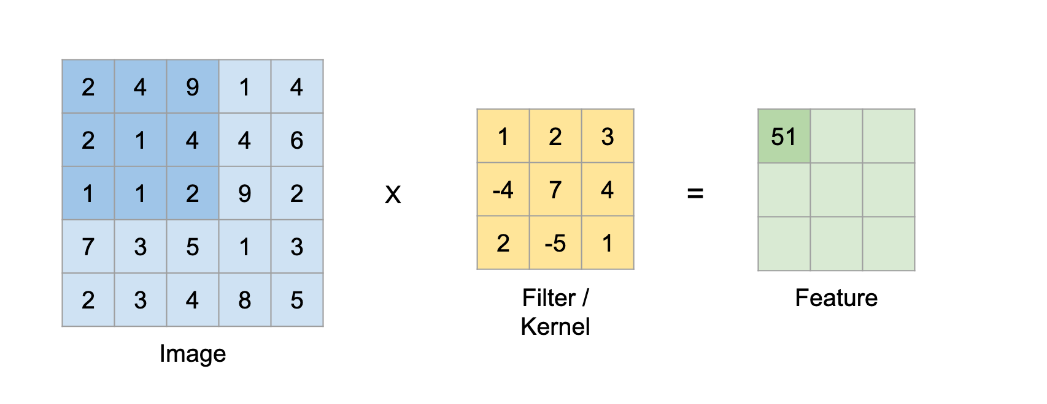
MODULE 3.1 - SIZE & TRAINABLE PARAMETERS
Reminder: what Conv2D is doing
Sliding kernel, stride 1, lots of overlap - the map shrinks a little. Light downsampling.
OPIM 5509 · Introduction to Deep Learning
6
Notes:
Quick recall, then we start counting.

Slide 7
MODULE 3.1 - SIZE & TRAINABLE PARAMETERS
Start here: the input image
INPUT
Conv2D 3 @ 5x5
MaxPool 2x2
Conv2D 5 @ 3x3
MaxPool 2x2
Flatten
Dense 256
Dense 2
(None, 28, 28, 1)
(None, 24, 24, 3)
(None, 12, 12, 3)
(None, 10, 10, 5)
(None, 5, 5, 5)
(None, 125)
(None, 256)
(None, 2)
OUTPUT SIZE
TRAINABLE PARMS
Given in the code:
input_shape = (28, 28, 1)
(None, 28, 28, 1)
Nothing to learn yet...
0 parms
RUNNING TOTAL: 0
OPIM 5509 · Introduction to Deep Learning
7
Notes:
One grayscale channel. Batch prints as None - decided at fit time.

Slide 8
MODULE 3.1 - SIZE & TRAINABLE PARAMETERS
Layer 1 - Conv2D: 3 maps @ 5x5
INPUT
Conv2D 3 @ 5x5
MaxPool 2x2
Conv2D 5 @ 3x3
MaxPool 2x2
Flatten
Dense 256
Dense 2
(None, 28, 28, 1)
(None, 24, 24, 3)
(None, 12, 12, 3)
(None, 10, 10, 5)
(None, 5, 5, 5)
(None, 125)
(None, 256)
(None, 2)
78
OUTPUT SIZE
TRAINABLE PARMS
28 - (5 - 1)
= 24 -> (None, 24, 24, 3)
((5 x 5 x 1) + 1) x 3
= 78 parms
RUNNING TOTAL: 78
OPIM 5509 · Introduction to Deep Learning
8
Notes:
First conv: L=1 (grayscale). 25 weights + 1 bias per filter, 3 filters. Output channels = F = 3.

Slide 9
MODULE 3.1 - SIZE & TRAINABLE PARAMETERS
Layer 2 - MaxPooling 2x2
INPUT
Conv2D 3 @ 5x5
MaxPool 2x2
Conv2D 5 @ 3x3
MaxPool 2x2
Flatten
Dense 256
Dense 2
(None, 28, 28, 1)
(None, 24, 24, 3)
(None, 12, 12, 3)
(None, 10, 10, 5)
(None, 5, 5, 5)
(None, 125)
(None, 256)
(None, 2)
78
0
OUTPUT SIZE
TRAINABLE PARMS
24 / 2
= 12 -> (None, 12, 12, 3)
Nothing is learned - naive max
0 parms
RUNNING TOTAL: 78
OPIM 5509 · Introduction to Deep Learning
9
Notes:
2x2 kernel, stride 2, no overlap: halves it. Same 3 maps, just smaller.

Slide 10
MODULE 3.1 - SIZE & TRAINABLE PARAMETERS
Layer 3 - Conv2D: 5 maps @ 3x3
INPUT
Conv2D 3 @ 5x5
MaxPool 2x2
Conv2D 5 @ 3x3
MaxPool 2x2
Flatten
Dense 256
Dense 2
(None, 28, 28, 1)
(None, 24, 24, 3)
(None, 12, 12, 3)
(None, 10, 10, 5)
(None, 5, 5, 5)
(None, 125)
(None, 256)
(None, 2)
78
0
140
CAREFUL: L = 3 (maps coming IN), F = 5 (maps we MAKE)!
OUTPUT SIZE
TRAINABLE PARMS
12 - (3 - 1)
= 10 -> (None, 10, 10, 5)
((3 x 3 x 3) + 1) x 5
= 140 parms
RUNNING TOTAL: 78 + 140 = 218
OPIM 5509 · Introduction to Deep Learning
10
Notes:
THE TRAP SLIDE. L=3 because pooling handed us 3 maps; F=5 because WE asked for 5. Each filter is a 3x3x3 brick (27 weights + 1 bias = 28), x5 filters = 140. Three in, five out - the two numbers do different jobs!

Slide 11
MODULE 3.1 - SIZE & TRAINABLE PARAMETERS
Layer 4 - MaxPooling 2x2
INPUT
Conv2D 3 @ 5x5
MaxPool 2x2
Conv2D 5 @ 3x3
MaxPool 2x2
Flatten
Dense 256
Dense 2
(None, 28, 28, 1)
(None, 24, 24, 3)
(None, 12, 12, 3)
(None, 10, 10, 5)
(None, 5, 5, 5)
(None, 125)
(None, 256)
(None, 2)
78
0
140
0
OUTPUT SIZE
TRAINABLE PARMS
10 / 2
= 5 -> (None, 5, 5, 5)
Still nothing to learn
0 parms
RUNNING TOTAL: 218
OPIM 5509 · Introduction to Deep Learning
11
Notes:
Halve it again. Dense 5x5x5 nuggets of information now.

Slide 12
MODULE 3.1 - SIZE & TRAINABLE PARAMETERS
Layer 5 - Flatten
INPUT
Conv2D 3 @ 5x5
MaxPool 2x2
Conv2D 5 @ 3x3
MaxPool 2x2
Flatten
Dense 256
Dense 2
(None, 28, 28, 1)
(None, 24, 24, 3)
(None, 12, 12, 3)
(None, 10, 10, 5)
(None, 5, 5, 5)
(None, 125)
(None, 256)
(None, 2)
78
0
140
0
0
OUTPUT SIZE
TRAINABLE PARMS
5 x 5 x 5
= 125 -> (None, 125)
Just reshaping - no weights
0 parms
RUNNING TOTAL: 218
OPIM 5509 · Introduction to Deep Learning
12
Notes:
Unroll the maps into one row of 125 numbers - like the first row of a dataframe. Ready for dense layers.

Slide 13
MODULE 3.1 - SIZE & TRAINABLE PARAMETERS
Layer 6 - Dense 256
INPUT
Conv2D 3 @ 5x5
MaxPool 2x2
Conv2D 5 @ 3x3
MaxPool 2x2
Flatten
Dense 256
Dense 2
(None, 28, 28, 1)
(None, 24, 24, 3)
(None, 12, 12, 3)
(None, 10, 10, 5)
(None, 5, 5, 5)
(None, 125)
(None, 256)
(None, 2)
78
0
140
0
0
32,256
OUTPUT SIZE
TRAINABLE PARMS
256 hidden units
(None, 256)
(125 + 1) x 256
= 32,256 parms
RUNNING TOTAL: 218 + 32,256 = 32,474
OPIM 5509 · Introduction to Deep Learning
13
Notes:
Module 2 formula, unchanged. This is where most of the parms live.

Slide 14
MODULE 3.1 - SIZE & TRAINABLE PARAMETERS
Layer 7 - Dense 2 (softmax)
INPUT
Conv2D 3 @ 5x5
MaxPool 2x2
Conv2D 5 @ 3x3
MaxPool 2x2
Flatten
Dense 256
Dense 2
(None, 28, 28, 1)
(None, 24, 24, 3)
(None, 12, 12, 3)
(None, 10, 10, 5)
(None, 5, 5, 5)
(None, 125)
(None, 256)
(None, 2)
78
0
140
0
0
32,256
514
OUTPUT SIZE
TRAINABLE PARMS
2 output nodes
(None, 2)
(256 + 1) x 2
= 514 parms
RUNNING TOTAL: 32,474 + 514 = 32,988
OPIM 5509 · Introduction to Deep Learning
14
Notes:
Binary classification, softmax over 2 nodes. Regression would be 1 node, linear.

Slide 15
MODULE 3.1 - SIZE & TRAINABLE PARAMETERS
The whole chain - check the summary
INPUT
Conv2D 3 @ 5x5
MaxPool 2x2
Conv2D 5 @ 3x3
MaxPool 2x2
Flatten
Dense 256
Dense 2
(None, 28, 28, 1)
(None, 24, 24, 3)
(None, 12, 12, 3)
(None, 10, 10, 5)
(None, 5, 5, 5)
(None, 125)
(None, 256)
(None, 2)
78
0
140
0
0
32,256
514
TOTAL = 78 + 140 + 32,256 + 514 = 32,988
exactly what model.summary() prints - run the notebook and check yourself
If your chain matches the summary shape-for-shape and parm-for-parm, you own this material.
OPIM 5509 · Introduction to Deep Learning
15
Notes:
Pt 1 ends here. The chain IS the cheat-sheet answer table.

Slide 16
MODULE 3.1 - SIZE & TRAINABLE PARAMETERS
Round 2: ugly numbers (no eyeballing!)
Conv2D 29 @ 5x5
(None, 24, 24, 29)
((5x5x1)+1) x 29 = 754
MaxPool 2x2
(None, 12, 12, 29)
0
Conv2D 87 @ 3x3
(None, 10, 10, 87)
((3x3x29)+1) x 87 = 22,794
MaxPool 2x2 -> Flatten
(None, 5, 5, 87) -> (None, 2175)
0
Dense 256 -> Dense 2
(None, 256) -> (None, 2)
(2175+1)x256 = 557,056 · (256+1)x2 = 514
29 maps and 87 filters exist so you CANNOT eyeball it - the formula is the only way through. Try before peeking!
OPIM 5509 · Introduction to Deep Learning
16
Notes:
Pt 2: model 2 in the notebook. The calculator cell proves 22,794.

Slide 17
MODULE 3.1 - SIZE & TRAINABLE PARAMETERS
Round 3: play with channels
GRAYSCALE (L = 1)
NOW MAKE IT RGB (L = 3)
((5 x 5 x 1) + 1) x 29
= 754 parms
((5 x 5 x 3) + 1) x 29
= 2,204 parms
PREDICT before you run the cell.
Then grab the cheat sheet and do one full chain by hand - that is the whole assignment-prep loop.
OPIM 5509 · Introduction to Deep Learning
17
Notes:
Pt 3: change channels 1->3 in input_shape. Only the FIRST conv layer changes.

Slide 18
MODULE 3.1 - SIZE & TRAINABLE PARAMETERS
Your toolkit
THE NOTEBOOK
THE CHEAT SHEET
THE PLAYGROUND
Simple_Size_and_Param.ipynb
ConvNet Math Cheat Sheet
setosa.io/ev/image-kernels
both models pre-built: run, then rebuild by hand
every formula + a worked answer table
drag kernel values, watch the image respond
All three are linked on the HuskyCT M3.1 page.
OPIM 5509 · Introduction to Deep Learning
18
Notes:
Wrap the recorded portion here.

Slide 19
APPENDIX
Kernels in action: the gallery
Screenshots from setosa.io/ev/image-kernels: the same face through different kernels - watch the dot product panel build each output pixel.
Notes:
Optional to record - flip through a couple of kernels and connect back to the setosa demo from video 1.

Slide 20
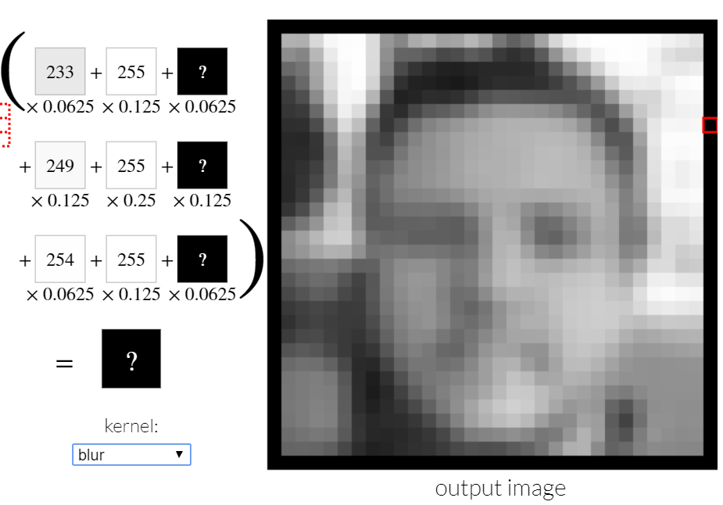
OPIM 5509 · Introduction to Deep Learning
20

Slide 21
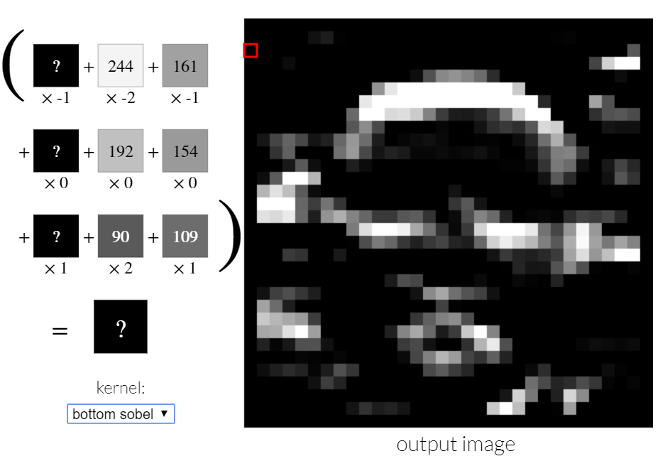
OPIM 5509 · Introduction to Deep Learning
21

Slide 22
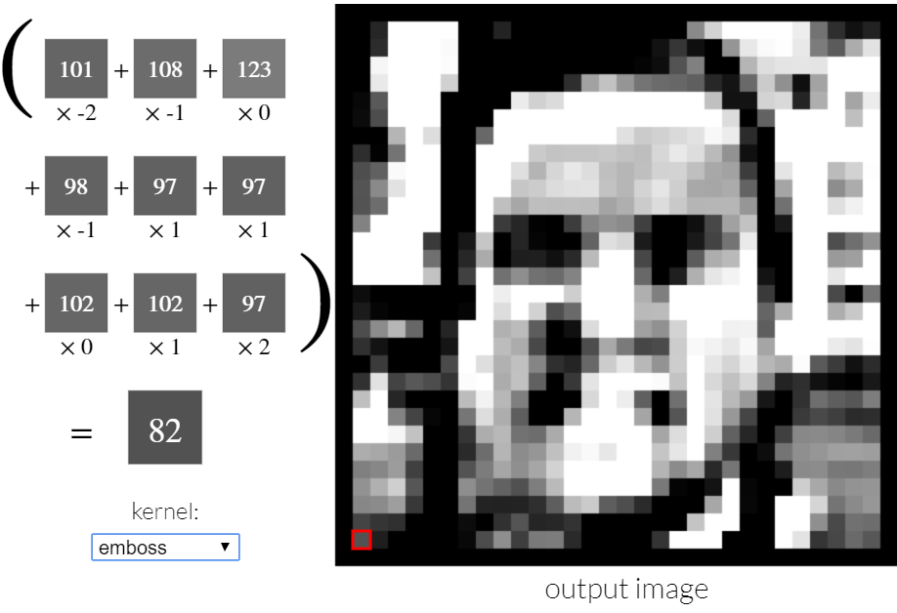
OPIM 5509 · Introduction to Deep Learning
22

Slide 23
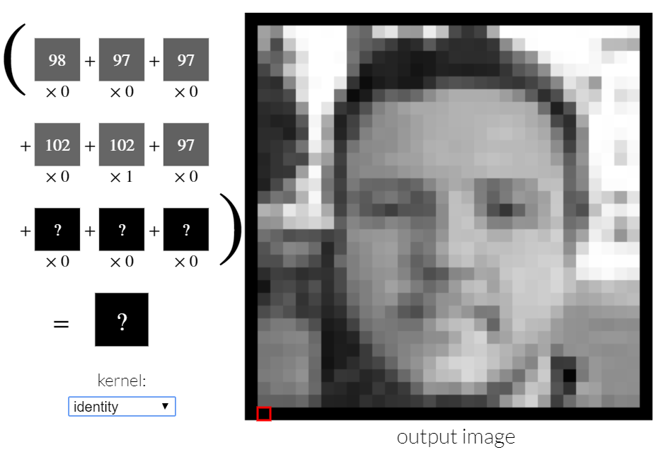
OPIM 5509 · Introduction to Deep Learning
23

Slide 24
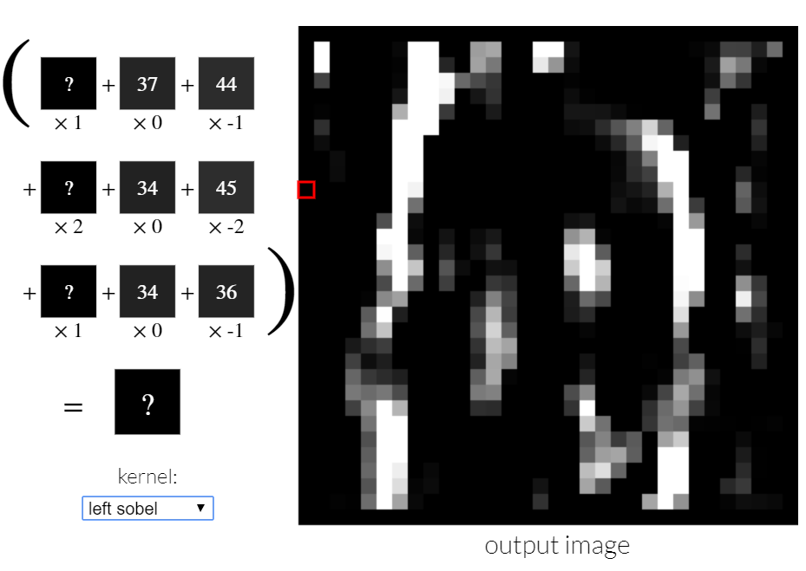
OPIM 5509 · Introduction to Deep Learning
24

Slide 25
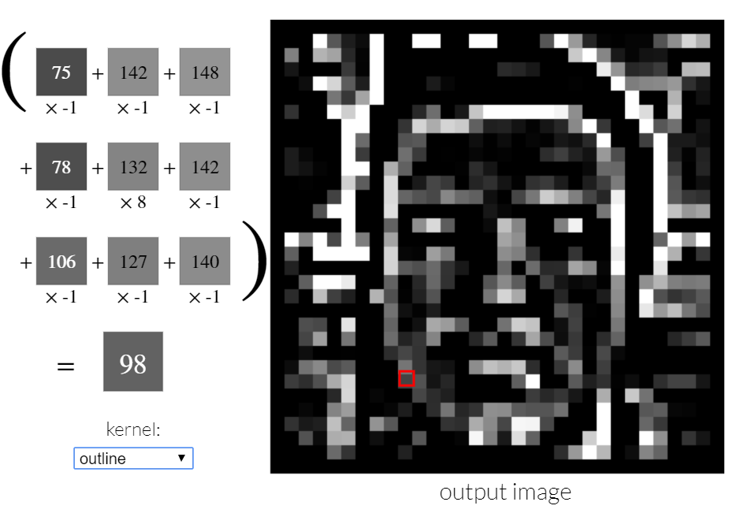
OPIM 5509 · Introduction to Deep Learning
25

Slide 26
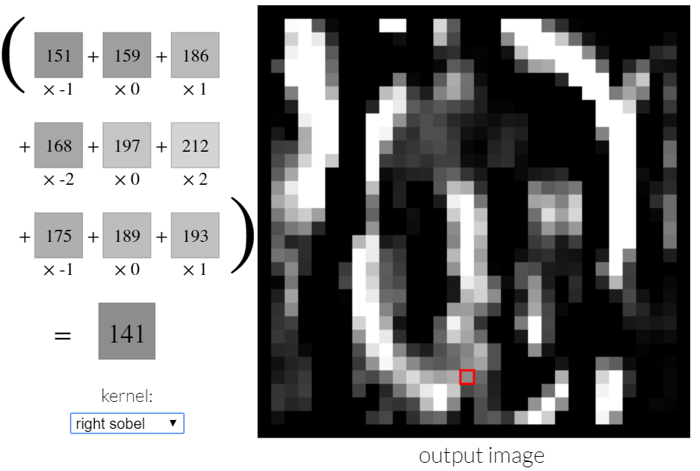
OPIM 5509 · Introduction to Deep Learning
26

Slide 27
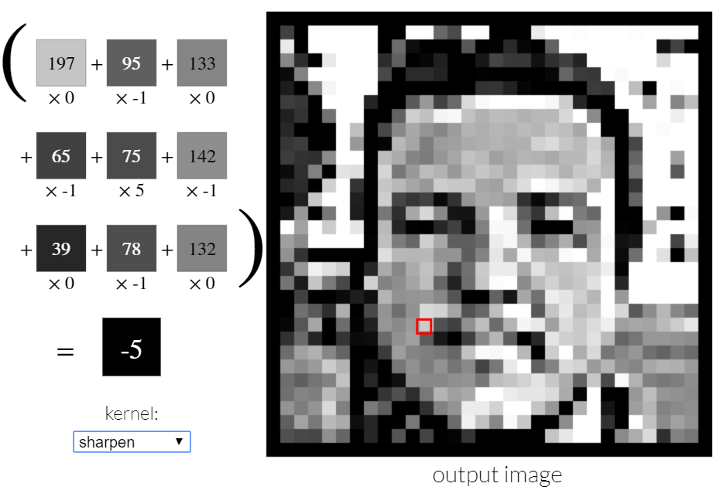
OPIM 5509 · Introduction to Deep Learning
27

Slide 28
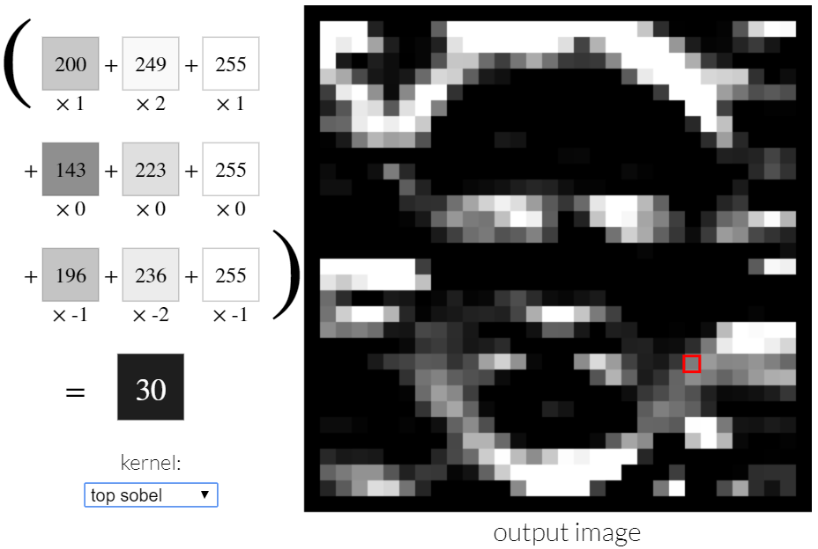
OPIM 5509 · Introduction to Deep Learning
28

Slide 29
APPENDIX
Good links (great reading, too)
Visualizing ConvNets with Keras and cats
hackernoon.com/visualizing-parts-of-convolutional-neural-networks-using-keras-and-cats-5cc01b214e59
Image kernels, explained visually
setosa.io/ev/image-kernels
Easy-peasy 2D convolution (with video)
ricardodeazambuja.com - easy-peasy_conv_deep_learning_two
Stanford CS231n ConvNet notes
cs231n.github.io/convolutional-networks
The StackOverflow param-counting classic
stackoverflow.com/questions/42786717
OPIM 5509 · Introduction to Deep Learning
29
Notes:
All verified alive Sep 2026.

